Slide 1
Data Preprocessing & Visualization
Session 3: (Matplotlib & Seaborn)

Slide 2
Agenda:
1 | Introduction to Matplotlib
2 | Introduction to Seaborn
3 | Practical Visualization Examples

Slide 3
Introduction to Matplotlib

Slide 4
Introduction to Matplotlib
What is Matplotlib?
Matplotlib is a comprehensive library for creating static, animated, and interactive visualizations in Python. It is highly customizable and is widely used for producing high-quality 2D graphics.
It provides a MATLAB-like interface via the pyplot module, making it easy to create plots by calling a series of simple functions.

Slide 5
Key Features of Matplotlib
Line Plots: Basic line plots for showing trends over time.
Scatter Plots: For visualizing the relationship between two numerical variables.
Bar Charts: Displaying categorical data with rectangular bars.
Histograms: Showing the distribution of numerical data.
Subplots: Creating multiple plots within a single figure.
Customization: Highly customizable with titles, labels, legends, colors, and more

Slide 6
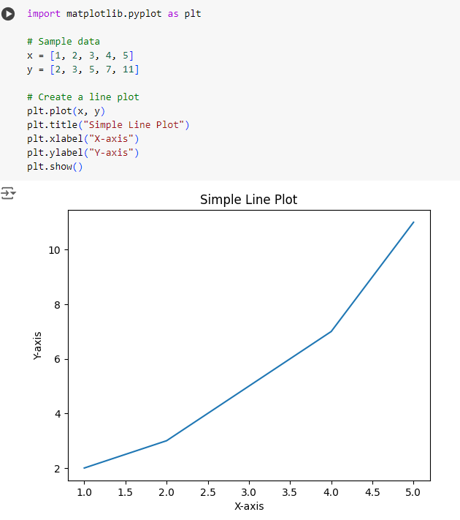
Basic Plotting with Matplotlib
Line Plot
This creates a basic line plot with x and y data points. plt.title(), plt.xlabel(), and plt.ylabel() add a title and labels to the axes.

Slide 7
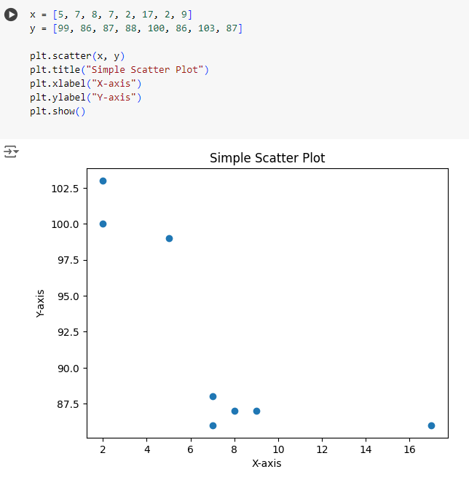
Basic Plotting with Matplotlib
Scatter Plot
A scatter plot is used to observe the relationship between two variables. plt.scatter() creates a scatter plot with x and y coordinates.

Slide 8
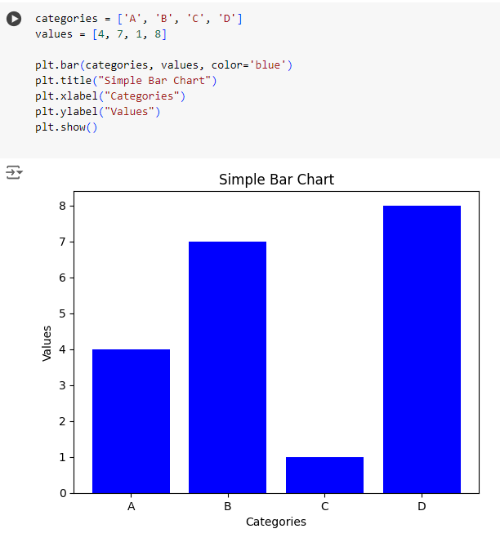
Basic Plotting with Matplotlib
Bar Chart
A bar chart displays data with rectangular bars. plt.bar() is used to create a bar chart with specified categories and their corresponding values.

Slide 9
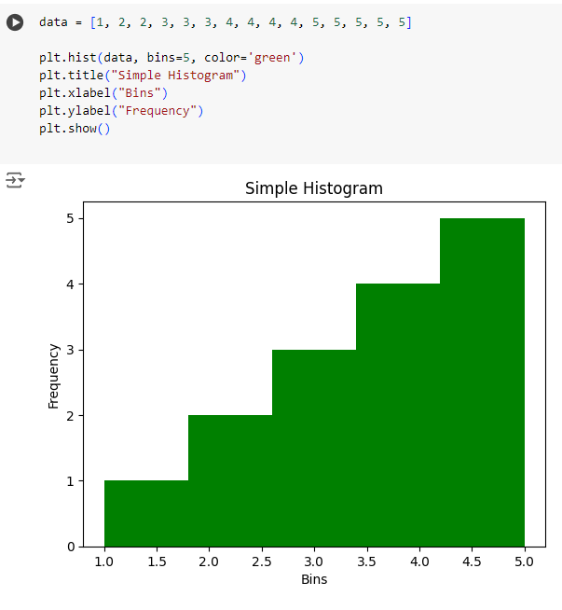
Basic Plotting with Matplotlib
Histogram
A histogram is used to show the distribution of a numerical variable. plt.hist() creates a histogram with a specified number of bins.

Slide 10
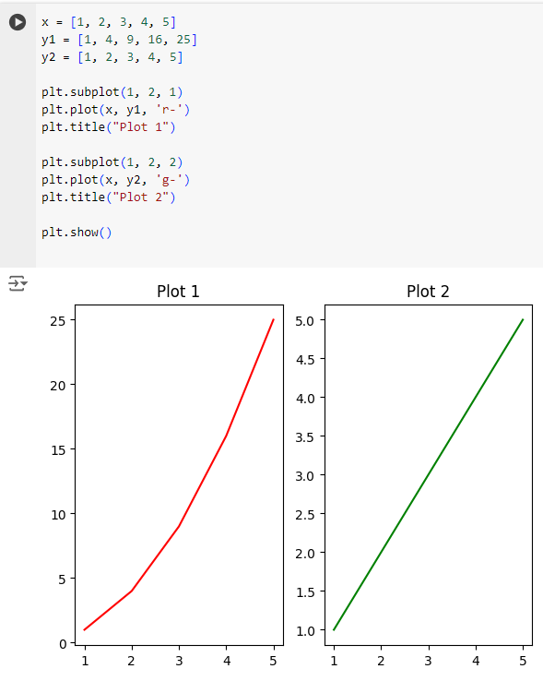
Basic Plotting with Matplotlib
Subplots
Subplots allow multiple plots to be shown in a single figure. plt.subplot(1, 2, 1) creates the first subplot, and plt.subplot(1, 2, 2) creates the second.

Slide 11
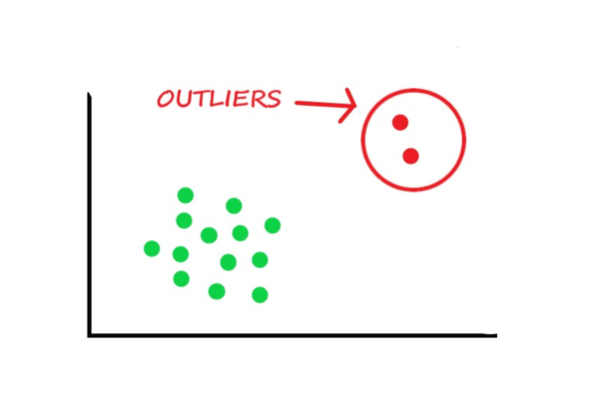
Outliers
Outliers are data points that significantly deviate from the rest of the data in a dataset. These anomalies can occur due to inconsistencies in measurement, errors during data collection, or actual variations. Outliers have the potential to distort statistical results and negatively influence machine learning models. Hence, it's crucial to detect and manage them effectively.

Slide 12
Identifying Outliers
Visualization Methods: Techniques such as box plots, scatter plots, histograms, and density plots are valuable tools for detecting outliers visually.
Box Plot: Displays data distribution, highlighting outliers as individual points outside the whiskers.
Scatter Plot: Shows relationships between variables, where outliers can be seen as points far from the main cluster.
Histogram: Illustrates the frequency of data points, with outliers appearing as bars that are distant from the rest.
Density Plot: Provides a smooth curve of the data distribution, with outliers showing up as irregular bumps outside the main peak.

Slide 13
Introduction to Seaborn

Slide 14
Introduction to Seaborn
What is Seaborn?
Seaborn is a Python data visualization library based on Matplotlib. It provides a high-level interface for drawing attractive and informative statistical graphics. Seaborn makes it easy to create complex visualizations, including relationships, categorical data, and statistical plots.

Slide 15
Key Features of Seaborn
Visualizing Distributions: Histograms, KDE plots, and rug plots.
Visualizing Categorical Data: Bar plots, count plots, box plots, and violin plots.
Visualizing Relationships: Scatter plots, line plots, and pair plots.
Heatmaps: For showing data correlations.
Themes: Built-in themes for better-looking plots.

Slide 16
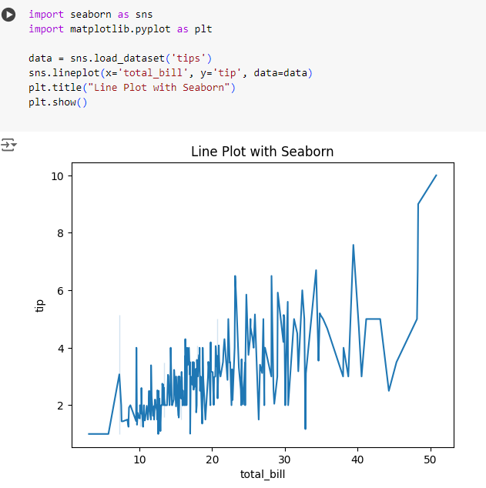
Basic Plotting with Seaborn
Line Plot
This uses Seaborn's lineplot() to create a line plot using the 'tips' dataset, showing the relationship between total bill and tip.

Slide 17
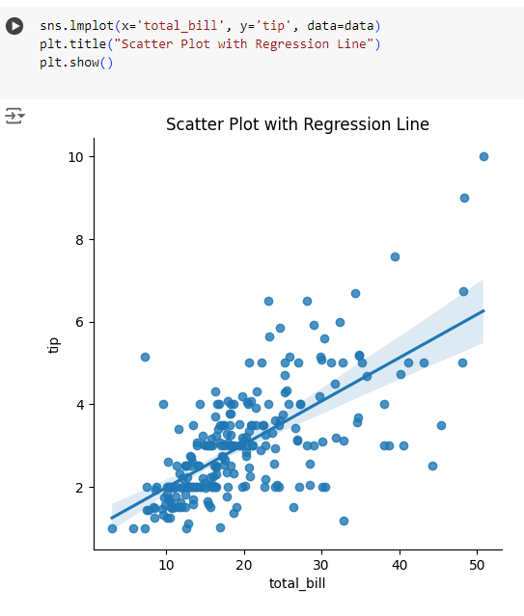
Basic Plotting with Seaborn
Scatter Plot with Regression Line
Seaborn's lmplot() creates a scatter plot with a linear regression line, illustrating the trend between total bill and tip.

Slide 18
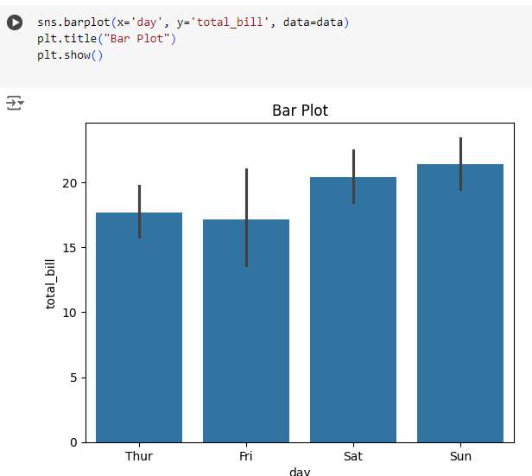
Basic Plotting with Seaborn
Bar Plot
barplot() creates a bar chart showing the average total bill for each day of the week. It aggregates the data automatically.

Slide 19
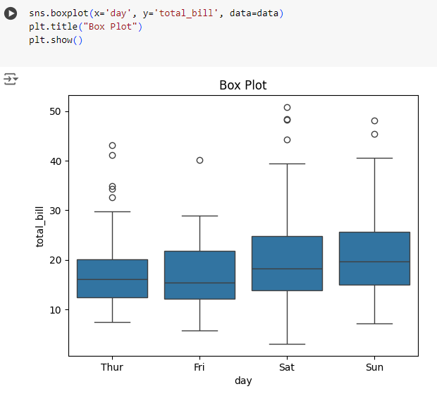
Basic Plotting with Seaborn
Box Plot
boxplot() is used to show the distribution of total bills across different days, highlighting the median, quartiles, and potential outliers.

Slide 20
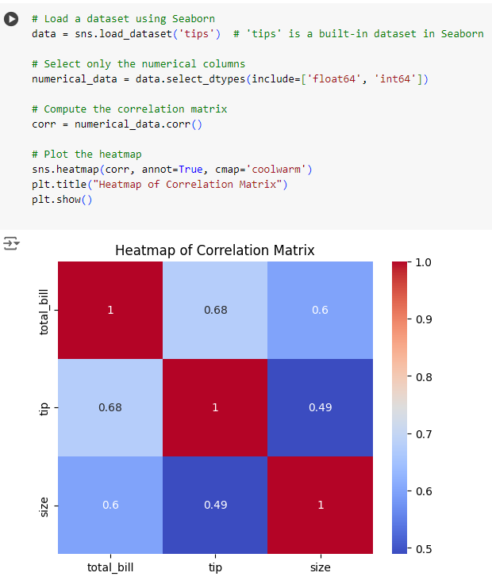
Basic Plotting with Seaborn
Heatmap
heatmap() visualizes the correlation matrix of the dataset, showing relationships between variables using color gradients.

Slide 21
Practical Visualization Examples

Slide 22
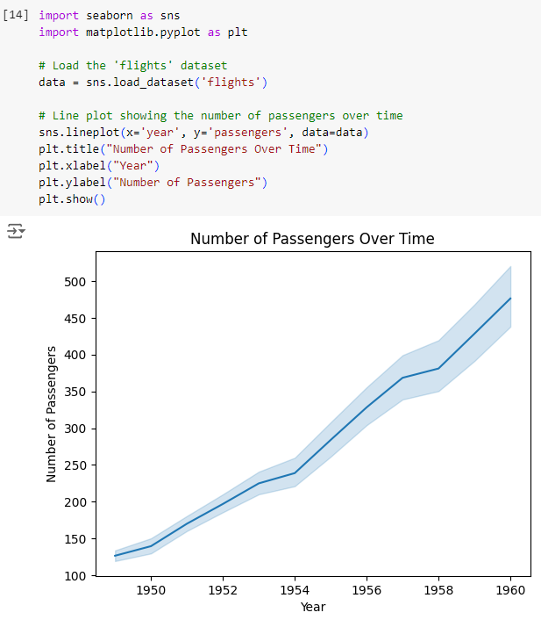
Practical Visualization Examples
Line Plot to Show Trends Over Time
This line plot shows the trend in the number of passengers over time using the 'flights' dataset. It helps to identify overall growth or decline trends.

Slide 23
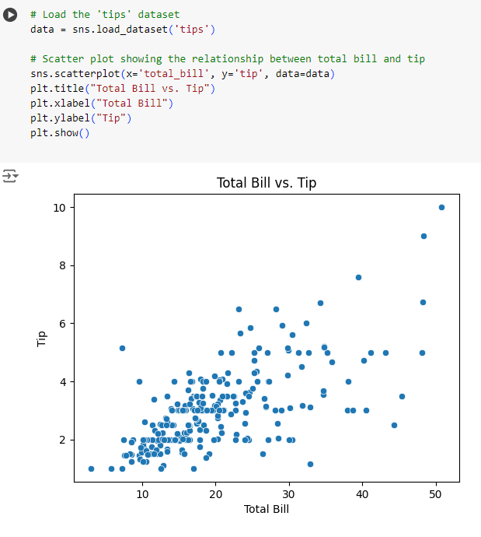
Practical Visualization Examples
Scatter Plot to Visualize Relationships Between Two Variables
A scatter plot shows the relationship between the total bill and the tip amount in the 'tips' dataset. It helps in identifying patterns or correlations.

Slide 24
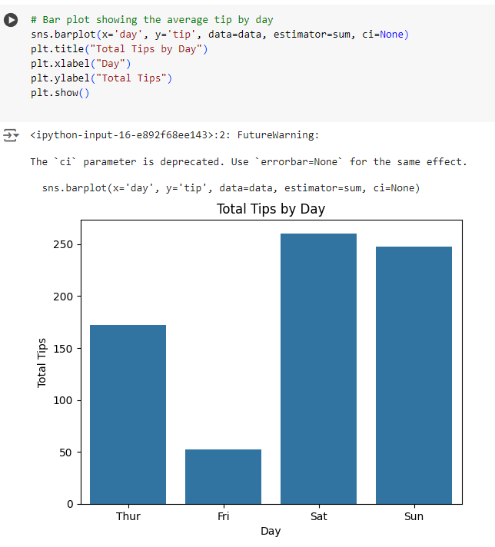
Practical Visualization Examples
Bar Plot to Show Categorical Data
This bar plot shows the sum of tips collected for each day. It's useful for comparing categorical data and understanding how different days perform in terms of tip collection.

Slide 25
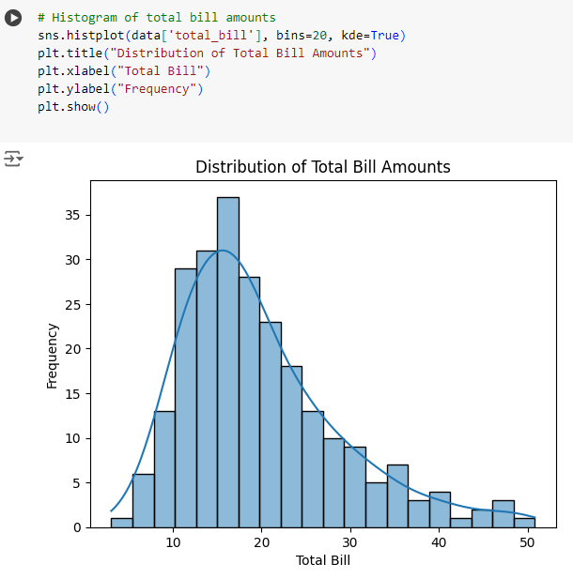
Practical Visualization Examples
Histogram to Show Data Distribution
This histogram displays the distribution of total bill amounts. The KDE (Kernel Density Estimate) line provides a smoothed version of the distribution, making it easier to see the underlying pattern.

Slide 26
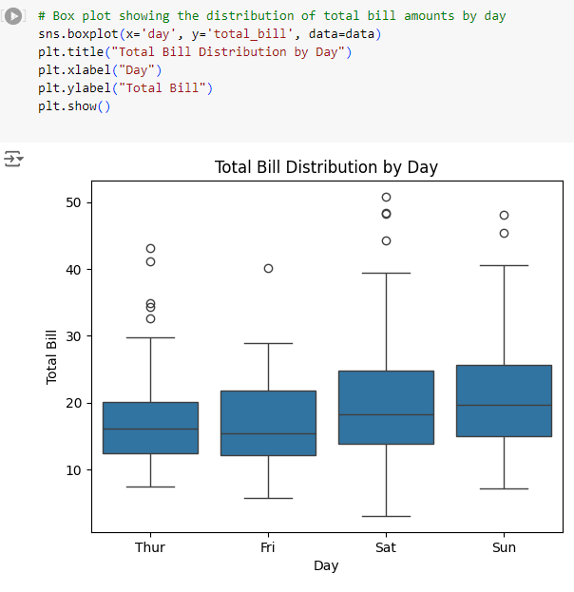
Practical Visualization Examples
Box Plot to Visualize Distribution and Outliers
Box plots provide a summary of the distribution, including median, quartiles, and potential outliers, for the total bill amounts categorized by day.

Slide 27
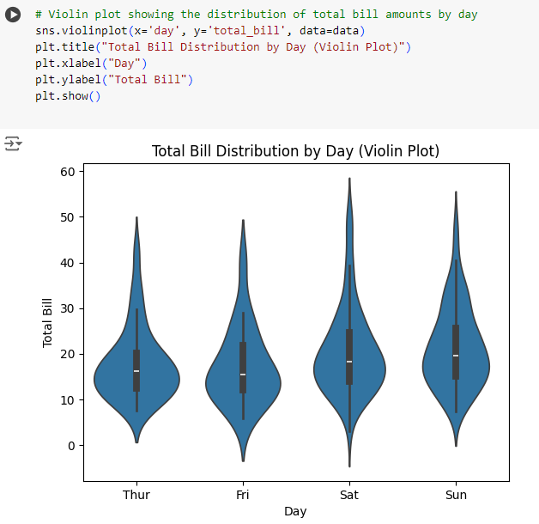
Practical Visualization Examples
Violin Plot to Show Density and Distribution
Violin plots combine the features of box plots and KDE, showing the distribution and density of total bill amounts by day.

Slide 28
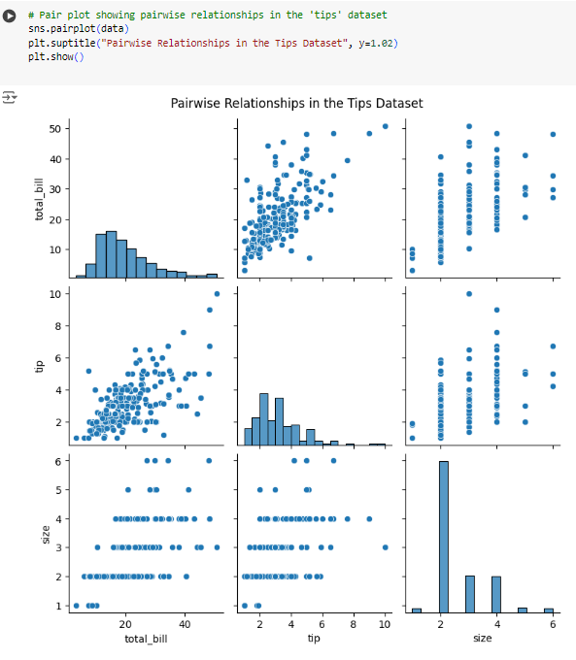
Practical Visualization Examples
Pair Plot to Show Pairwise Relationships
Pair plots display pairwise relationships between different numerical variables in the dataset, helping to identify potential correlations and distributions.

Slide 29
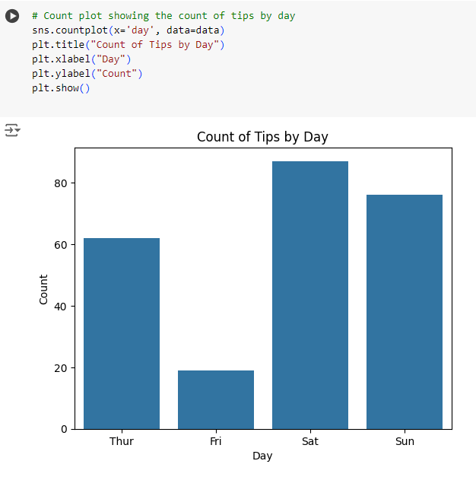
Practical Visualization Examples
Count Plot to Show the Frequency of Categorical Values
Count plots visualize the frequency of occurrences for categorical data. This example shows how many entries exist for each day in the 'tips' dataset.

Slide 30
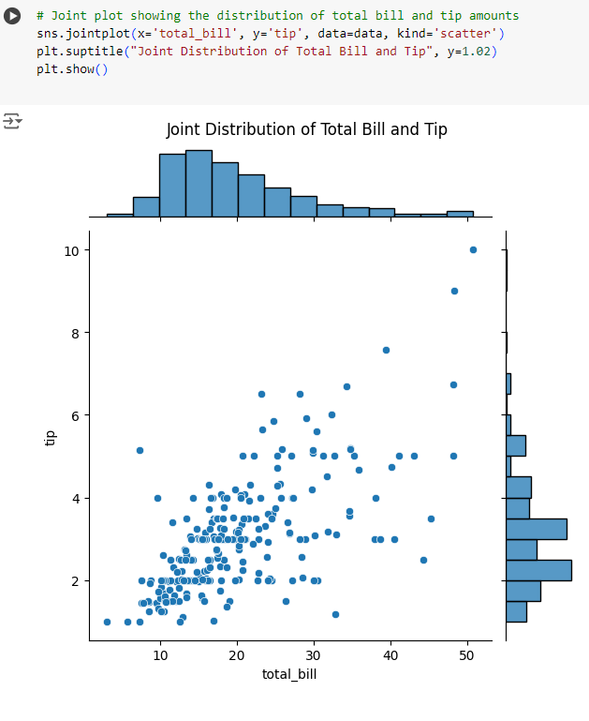
Practical Visualization Examples
Joint Plot to Show Distribution and Relationship
A joint plot combines a scatter plot and histograms, showing the relationship between total bill and tip amounts, along with their individual distributions.

